Slide 1
Market Basket Analysis
Statistical Computing Project (BANA 6043) Group #4
Contributors: Ashish Saxena, Lohit Borah, Tanmay Shrivastava, Pratibha Prakash Tiwari

Slide 2
Index
Problem Statement
Problem Definition
Executive Summary
Supporting Outcomes
Exploratory Data Analysis
Basket Analysis
New Functions Used & Context
R Code & Dataset (Embedded)
Attributes of the datasets used
Appendix

Slide 3
Problem Statement
Instacart is a grocery order and delivery app, which accepts grocery orders for various products and delivers them from various partnered stores to respective customers
The company wants to analyze its past transactional data to develop a recommendation system for its products so that they can effectively suggest associated items

Slide 4
Problem Definition
Current State
Desired State
Instacart is a grocery order and delivery app
It aims to make it easy to fill your pantry with your personal favorites and staples when you need them
The existing product recommendation system is manual rule-based and limited to a few of their top products/categories
Gap
Outcome: Instacart is able to recommend products effectively
Behavior: Instacart implement the new recommendation algorithm based on the findings and insights from the analysis
Insight: Instacart was able to identify the products which are frequently bought together
Instacart doesn’t have an effective products recommendation in place
Key Question
What are the products which are frequently bought together?

Slide 5
Executive Summary
Customers buying meat products, fresh fruits or meat alternatives should be recommended best selling products from fresh vegetables
Customers buying Yogurt should be recommended top 5 best selling flavors in the category
Customers buying dairy, eggs, frozen and canned foods should be recommended fresh vegetables
All customers buying protein bars should also be recommended other health products like Peanut Butter, Greek Yogurt & Nutrition Blends

Slide 6
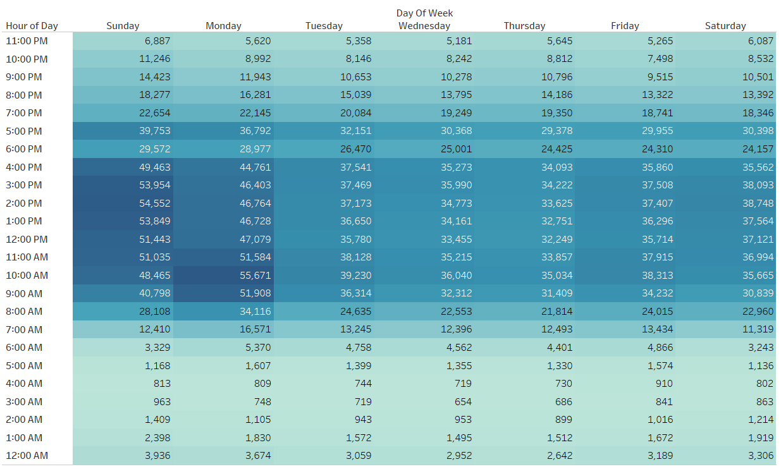
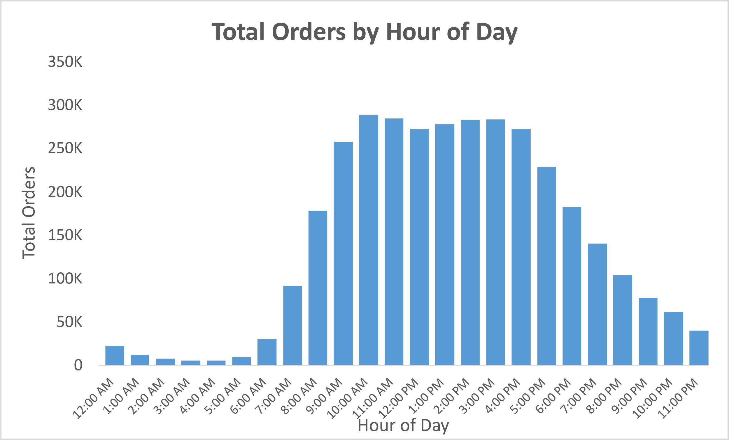
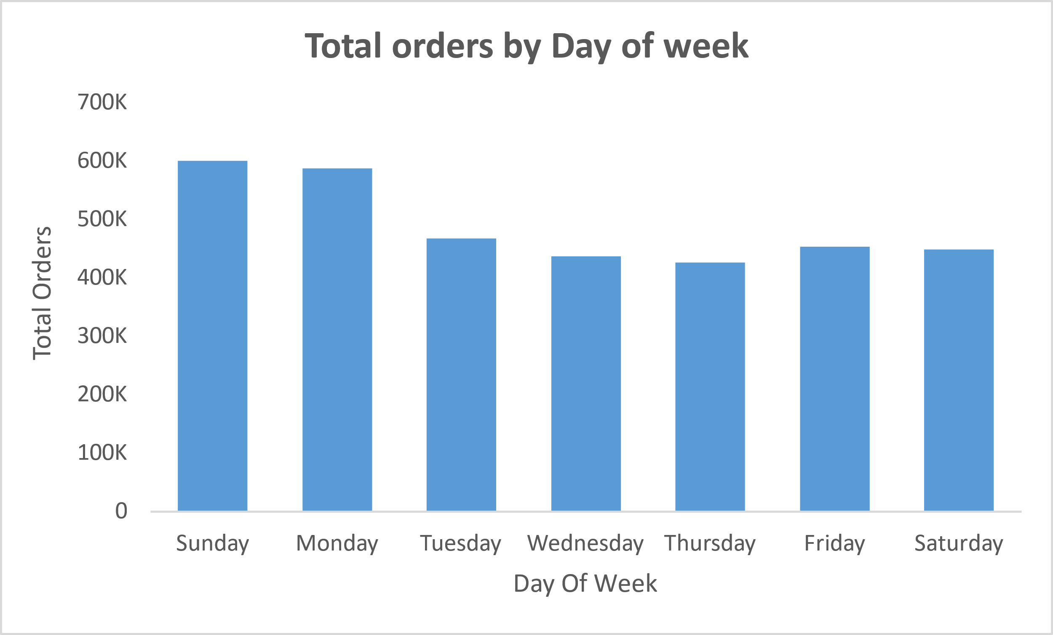
Mondays experienced highest orders between 9 AM – 11 AM
The highest number of orders were observed during 9 AM – 11 AM on Monday
The highest number of orders were recorded on Sundays and Mondays

Slide 7
Produce was the department with highest orders having ‘Fresh Fruits’ & ‘Fresh Vegetables’ as top categories
Fresh Fruits
3.8 M
Banana
491 K
Bag of Organic Bananas - 394 K
Organic Strawberries
276 K
Produce
9.9 M
Fresh Vegetables
3.6 M
Organic Yellow Onion - 118 K
Organic Garlic
114 K
Organic Zucchini
109 K
The department with highest number of orders is Produce with a total order of 9.9 M
Bananas were the most ordered Fresh Fruits followed by Strawberries
Organic Yellow Onion and Organic Garlic were the most ordered Fresh Vegetables

Slide 8
Diary Eggs was the department with second highest orders having ‘Yogurt’ & ‘Packaged Cheese’ as top categories
Yogurt
1.5 M
Total 2% Strained Yogurt - 31 K
Total 0% Nonfat Greek Yogurt - 28 K
Total Greek Strained Yogurt - 27 K
Dairy Eggs
5.6 M
Packaged Cheese
1.0 M
Organic Whole String Cheese - 62 K
Grated Parmesan
47 K
Shredded Parmesan
38 K
The department with second highest number of orders is Dairy Eggs with a total order of 5.6 M
Total 2% Strained Yogurt was the most ordered Yogurt followed by Total 0% Nonfat Greek Yogurt
Organic Whole String Cheese was the most ordered Packaged Cheese followed by Grated Parmesan

Slide 9
Snacks was the department with third highest orders having ‘Chips Pretzels’ & ‘Crackers’ as top categories
Chips Pretzels
754 K
Lightly Salted Baked Pea Crisps - 26 K
Sea Salt Pita Chips
17 K
Pretzel Crisps Crackers - 16 K
Snacks
3.0 M
Crackers
478 K
Crackers Cheddar Snack Packs - 13 K
Hint Of Sea Salt Almond Nut - 12 K
Cheddar Snack Crackers - 11 K
The department with third highest number of orders is Snacks with a total order of 3.0 M
Lightly Salted Baked Pea Crisps was the most ordered Chips Pretzels followed by Sea Salt Pita Chips
Crackers Cheddar Snack Packs and Hint Of Sea Salt Almond Nut were the most ordered Crackers

Slide 10

Produce, Dairy Eggs & Beverages experienced highest reorder percentages
55%
45%
45%
45% of total products were reordered
Department
Category
Products
Fresh Fruits – 83%*
Banana, Bag of Organic Bananas
Produce
76%*
Fresh Vegetables – 69%*
Organic Yellow Onion, Organic Garlic
Dairy Eggs
72%*
Yogurt – 71%*
Total 2% Greek Strained Yogurt, Total 0% Nonfat Greek Yogurt
Packaged Cheese – 68%*
Organic Whole String Cheese, Grated Parmesan
Water Seltzer Sparkling Water – 78%*
Sparkling Water Grapefruit, Spring Water
Beverages 73%*
Refrigerated – 74%*
100% Raw Coconut Water, Original Orange Juice
* Re-order percentage

Slide 11
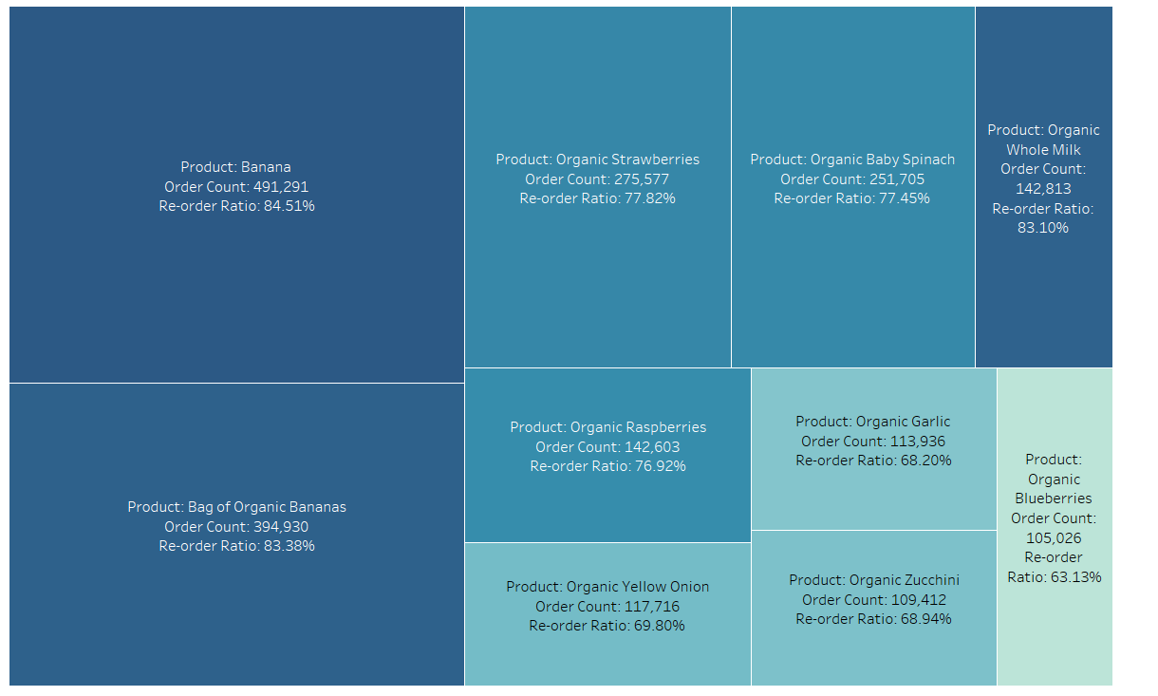
While Organic Whole Milk was ordered lesser times, it was the third most re-ordered product
Banana (84.51%) was the most re-ordered product followed by Organic Bananas (83.38%) & Organic Whole Milk (83.10%)
While Organic Strawberries was ordered significantly (over 275K orders), it was re-ordered 77.8%
Organic Blueberries was the least of top 10 re-ordered items (over 105K orders) with 63.13% re-orders

Slide 12
Associations across categories & within were observed for top selling products
Top Products | Products brought together **
Banana | {Organic Sweet Pea, Whole Hearts of Palm}, {Chicken Base, Organic Apple}, {Organic White Onions, Bing Cherries, Organic Granny Smith Apple, Organic Raspberries}
Bag of Organic Bananas | {Organic Sweet Vanilla Bean Nutrition Complete Protein Shake, Organic Strawberries},{Large Alfresco Eggs, Natural Chicken & Maple Breakfast Sausage Patty}
Organic Yellow Onion | {Small Hass Avocado, Organic Large Extra Fancy Fuji Apple, Gluten Free Steel Cut Oats}, {Banana, Multi-Seed Original Crackers, Just Green Unsweetened Tea}
Organic Garlic | {One French Vanilla Nutritional Shake, Whole Wheat Sourdough, Organic Whole Strawberries},{Organic Free Range Chicken Broth, Organic Baby Spinach}
Total 2% Greek Strained Yogurt | {Unsalted Pure Irish Butter, California Cauliflower, Original Instant Oatmeal, Boneless Skinless Chicken Thighs},{Original Real Vegetable Chips, Organic Fuji Apple}
Total 0% Nonfat Greek Yogurt | {Banana, Multi-Seed Original Crackers, Just Green Unsweetened Tea},{Granola Bar, Fig, Cranberry & Hazelnut, Vitamin Water Zero Rise Orange}
Organic Whole String Cheese | {Half & Half, Organic Mango Chunks, Bag of Organic Bananas},{Pure Goat Milk Cheese Log, Organic Navel Orange, Organic Tomato Cluster}
Grated Parmesan | {Lowfat Vanilla Yogurt, Organic Reduced Fat 2% Milk, Butterhead Lettuce, Honeycrisp Apple},{Nine Grain Sourdough Dough, Clementines, Bag}
Sparkling Water Grapefruit | {Bag of Organic Bananas, Large Alfresco Eggs, Natural Chicken & Maple Breakfast Sausage Patty, Organic Coconut Milk},
Spring Water | {Vitamin Water Zero Rise Orange, Original Pure Creamy Almond Milk},{Distilled Water, Organic Baby Spinach, Cole Slaw, Organic Mixed Baby Kale Salad}
100% Raw Coconut Water | {Sparkling Natural Mineral Water, Arancita Rossa, Organic Creamy Peanut Butter},{Sparkling Water Grapefruit, Bag of Organic Bananas, Large Alfresco Eggs}
Original Orange Juice | {Organic Apple Juice, Vanilla Bean Ice Cream, Organic Whole Milk}, {Pure Tart Cherry 100% Juice, Organic Cream Cheese Bar, Half & Half}
** Associations are not exhaustive

Slide 13
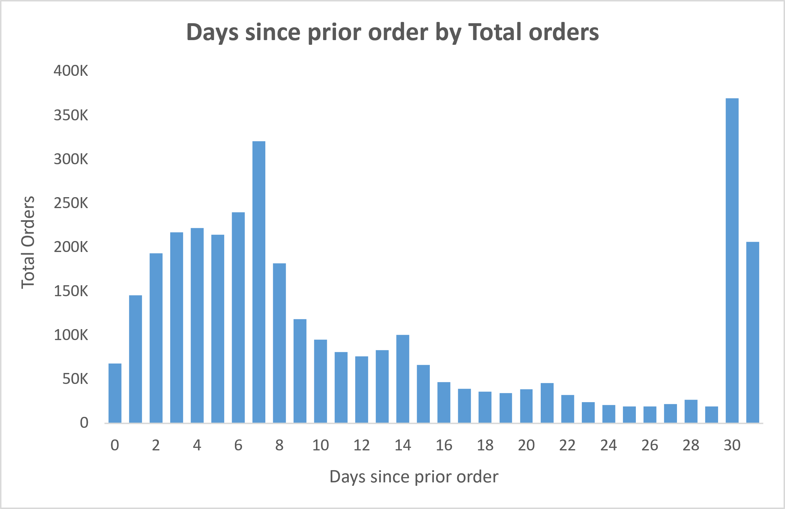
7th and 30th day observed highest re-orders with associations coherent with those on other days
Top Products | Products brought together **
Banana | {Organic Sweet Pea, Whole Hearts of Palm}, {Chicken Base, Organic Apple}, {Organic White Onions, Bing Cherries, Organic Granny Smith Apple, Organic Raspberries}
Bag of Organic Bananas | {Organic Sweet Vanilla Bean Nutrition Complete Protein Shake, Organic Strawberries},{Large Alfresco Eggs, Natural Chicken & Maple Breakfast Sausage Patty}
Organic Yellow Onion | {Small Hass Avocado, Organic Large Extra Fancy Fuji Apple, Gluten Free Steel Cut Oats}, {Banana, Multi-Seed Original Crackers, Just Green Unsweetened Tea}
Organic Garlic | {One French Vanilla Nutritional Shake, Whole Wheat Sourdough, Organic Whole Strawberries},{Organic Free Range Chicken Broth, Organic Baby Spinach}
Most re-orders were observed on 7th and 30th day from the previous order
Association of products bought together in basket showed similar trends as those on other days
** Associations are not exhaustive

Slide 14

Amongst the top products ordered individually in cart, soda exhibited the highest standalone ratio however still occurring in groups
Top Products
Standalone Ratio
Associations *
Bag of Organic Bananas
0.73%
{Organic Sweet Vanilla Bean Nutrition Complete Protein Shake, Organic Strawberries}
Soda
7.37%
{Crunch Granola Bar Chocolate Chip, Crunch White Chocolate Macadamia Nut Granola Bars}
Spring Water
3.72%
{Vitamin Water Zero Rise Orange, Original Pure Creamy Almond Milk}
Banana
0.43%
{Organic White Onions, Bing Cherries, Organic Granny Smith Apple, Organic Raspberries}
Organic Baby Spinach
0.48%
{Organic Large Grade AA Omega-3 Eggs, 100% Raw Coconut Water}
Standalone Ratio = $\frac{Orders with Only Product in cart}{Orders with Product in Cart}$
Cases of standalone products observed were very few
Such products were more observed more grouped with other products
Soda & Spring Water exhibited the highest standalone ratio amongst the top products
*Associations are not exhaustive

Slide 15
Market Basket Analysis & Results

Slide 16
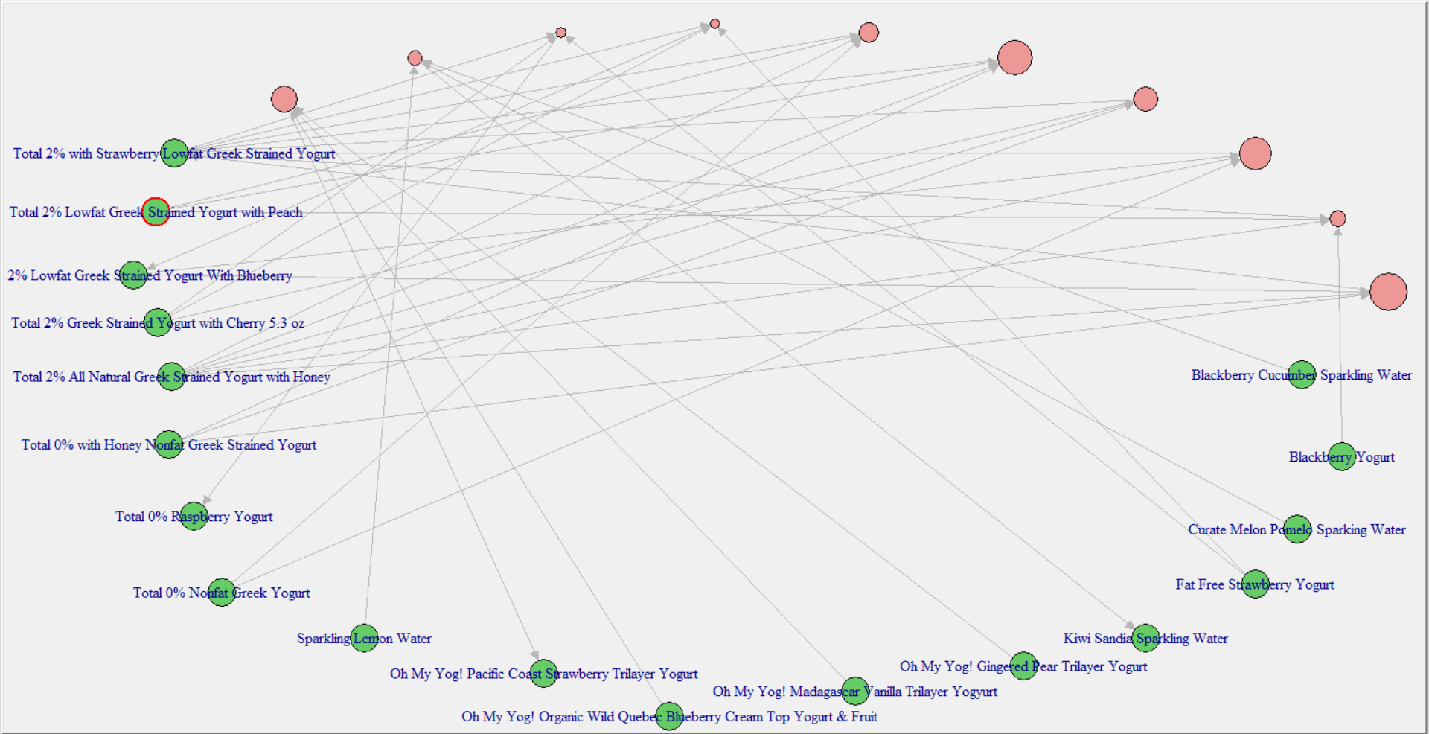
Associations with category ‘Fresh Vegetables’ were observed to show highest affinity
A support threshold of ‘0.0001’ with confidence of ‘0.8’ returned 59,430 rules
‘Fresh Vegetables’ showed the highest lift of 2.2
The most associated club was ‘{fresh herbs, meat counter, tofu meat alternatives}’ with 437 such associations
Note: Top 20 associations are showcased

Slide 17
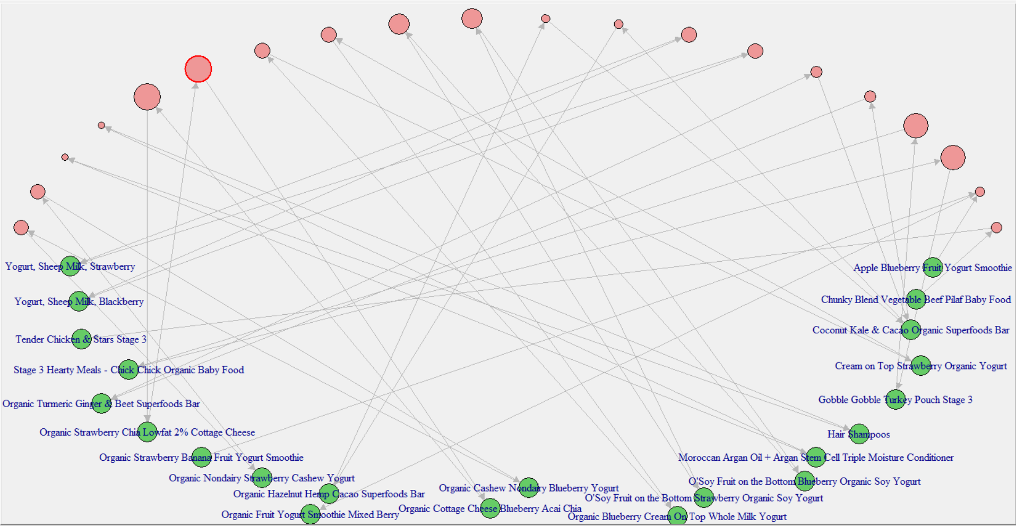
Strong associations were observed for products of type ‘Yogurt’
A support threshold of ‘0.0001’ with confidence of ‘0.1’ returned 70,437 rules
‘Organic Nondairy Strawberry Cashew Yogurt’ showed the highest lift of 2050
The most associated club was ‘{Organic Nondairy Blueberry Cashew Yogurt}’ with 416 such associations
Note: Top 20 associations are showcased

Slide 18
New Functions Used & Context
Function Name | Why was it used? / What does it do?
Apriori | To generate association rules across transaction with corresponding support, confidence and lift values
rbind | Used to combine data from two datasets : order_products__train, order_products__prior
left_join | To perform left join on the provided pair of datasets
inner_join | To perform inner join on the provided pair of datasets
colSums | To calculate columnar summation of Nas in dataset
unique.data.frame | To obtain unique values of specified columns in a dataset
coord_flip | To transpose a bar chart for better representation
top_n | To select top ‘n’ entities from a dataset
colnames | To enumerate the column names of the respective dataset
as.data.frame | To convert the desired output to a dataframe

Slide 19
R Code & Dataset link for the Project
R Code:
Dataset : Instacart Data

Slide 20
Attributes of the datasets used
Aisles (Category):
Aisle Id: A unique Id to represent each aisle
Aisle: Contains the name of aisle based on products on the aisle
Departments:
Department Id : Unique integer to represent each department
Department : String which tells the name of department depending upon products in department
Orders:
Order Id : Unique integer to represent order
User Id : Unique integer to represent different users
Eval Set : Tells whether order is from Prior or Train
Order Number : Order number for the order made by customer
Order Dow : Ranges from 0-6 where 0 = Sunday and 6 = Saturday
Order Hour Of Day : Ranges from 0-23 where 0 = 12 AM and 23 = 11 PM
Day Since Prior Order : Number of days since last order is placed

Slide 21
Attributes of the datasets used
Products:
Product Id : Unique Id for each product since there are huge number of products so will have large range
Product Name : Name of the product
Aisle Id : Id of the aisle where the product is present
Department Id : Unique Id for each department
Order Products Prior & Order Products Train:
Order Id : Unique integer to represent order
Product Id : Unique integer for each product
Add to cart order : Order in which product is added in the cart
Reordered : Binary variable (0 = Not reordered /1 = Reordered)

Slide 22
Appendix

Slide 23
Market Basket Analysis Overview
Market Basket Analysis is one of the key techniques used by retailers and e-commerce sites to understand which products are bought together by customers
This understanding of associated products help companies to make effective product recommendation by identifying relationships between the items that people buy
Association Rules are widely used to analyze retail basket or transaction data and are intended to identify strong rules discovered in transaction data using measures of interestingness, based on the concept of strong rules

Slide 24
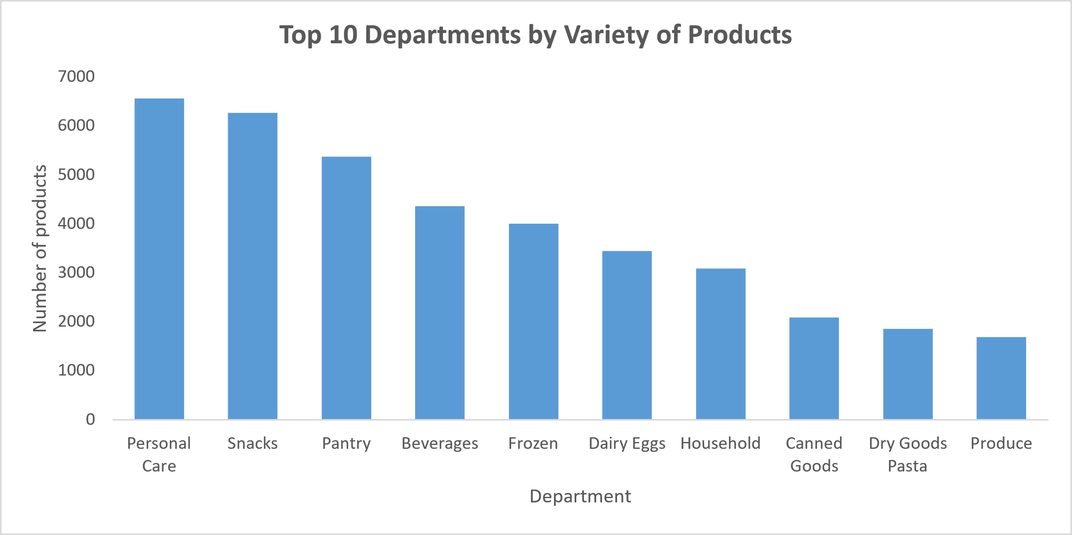
Personal Care and Snacks were the top departments by variety of products
Personal Care and Snacks are the departments with the highest variety of products
Pantry and Breakfast are the 3rd and 4th highest department

Slide 25
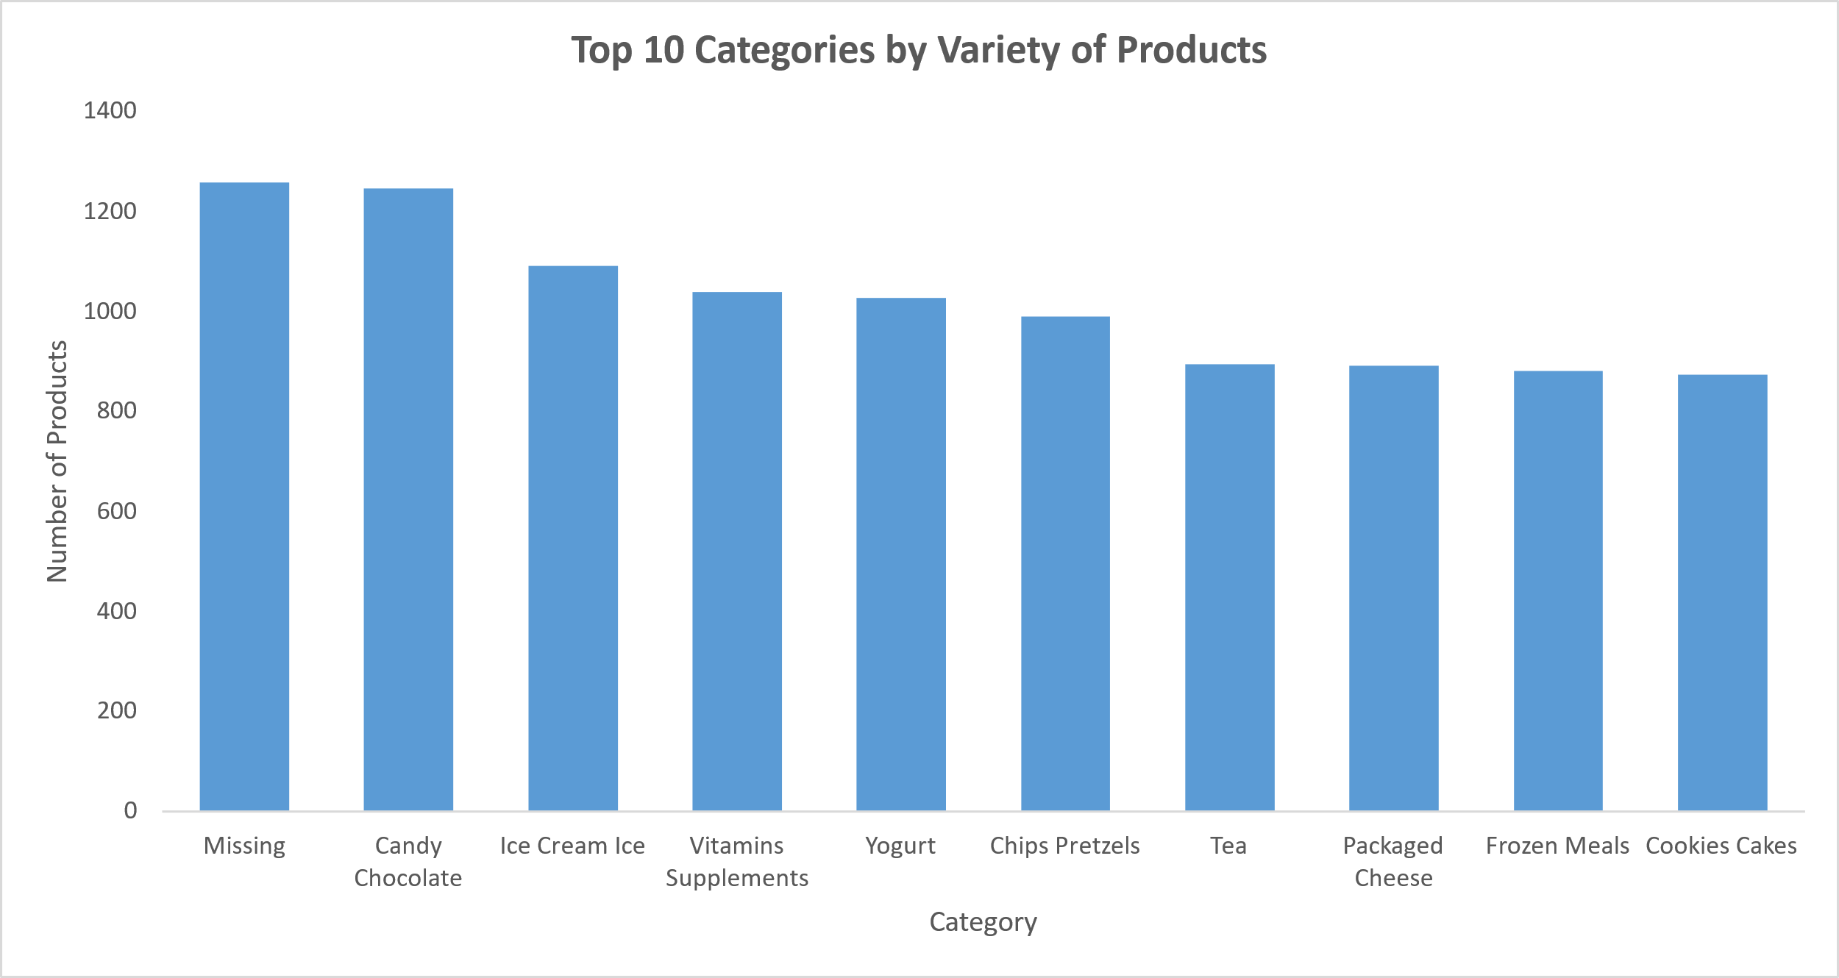
Candy Chocolate was the top category by variety of products
Candy Chocolate was the top category with highest variety of products
Ice Cream, Vitamins Supplements, Yogurt and Chips Pretzels were other top categories by variety

Slide 26
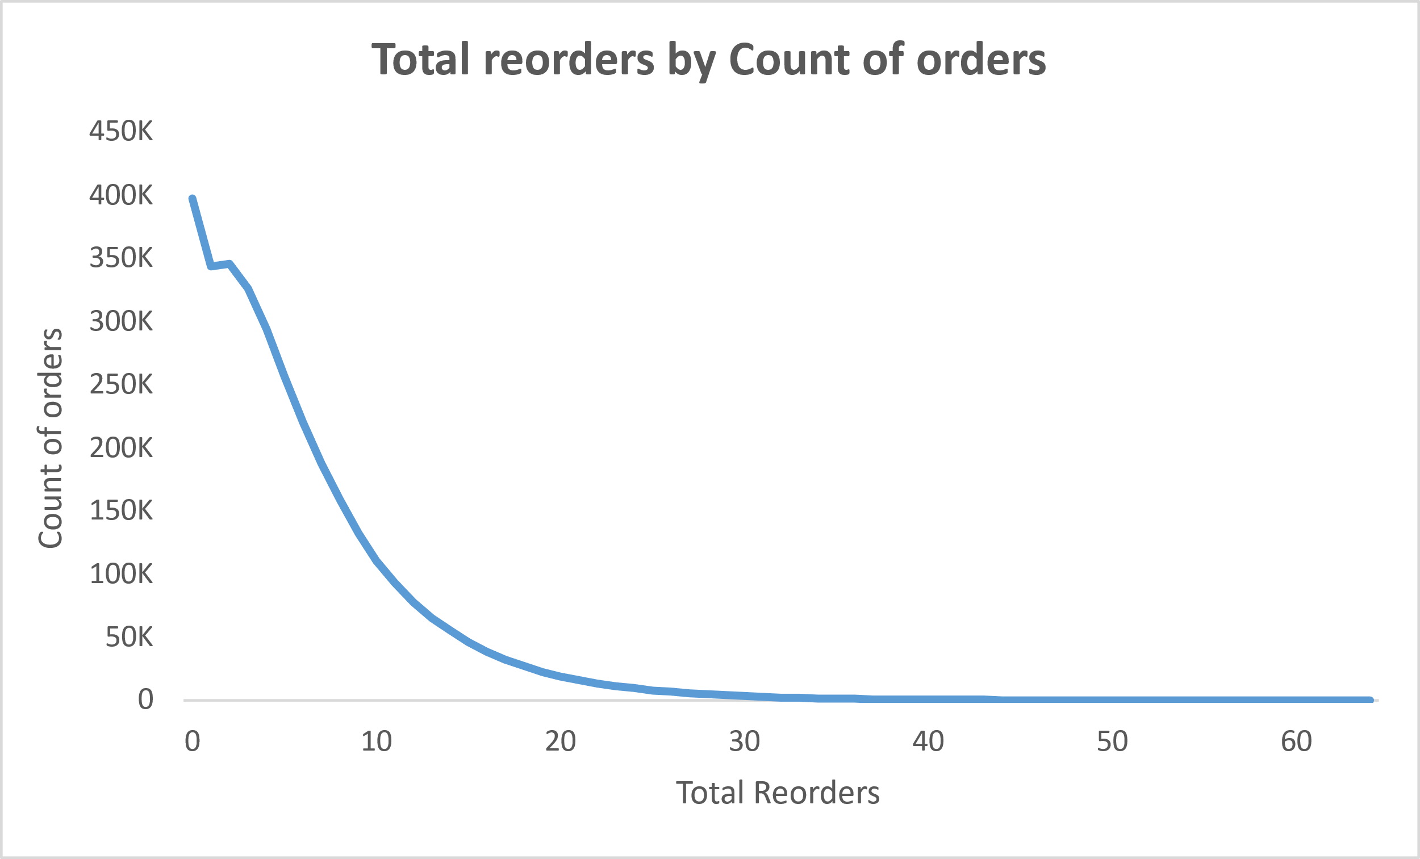
Most of the reorder have less than 10 reordered items
Most of the orders have less than 10 reordered items
Number of orders begin to decrease as re-ordered products in cart increase

Slide 27
Thank You!

